Slide 1
Middlebox Measurement
and Cooperation
Mirja Kühlewind and Brian Trammell, ETH Zürich
CleanSky Workshop Heidelberg, 29 Feb 2016

Slide 2
Problem Statement:
Ossification of the Internet due to Middlebox Impairments
Problem
Middleboxes make restrictive, implicit assumptions about traffic passing through them
Deployment of "new" protocols/extension limited by packet/flow modifications of middleboxes
Goal
Reduce the accidental manipulation to zero, while minimizing the essential manipulation!
Needed
More data about the nature and distribution of middlebox impairments
Common data model for storage and analysis of middlebox impairment
Explicit Middlebox cooperation to declare assumptions and intentions independent of the used transport or higher-layer protocol
New (UDP-based) transport encapsulation + in-band signaling

Slide 3



The MAMI Project
Measurement and Architecture for a Middleboxed Internet
Strong interaction with relevant standards organizations for impact on deployment
FIRE testbed (MONROE) support for measurement as well as experimentation, especially on mobile broadband access networks
Learn more at http://mami-project.eu/
of deployed middleboxes
for middlebox cooperation
of use case applicability and deployability

Slide 4
Middlebox Measurements:
Golas and Overview
Large-scale measurements of path impairments
using FIRE MONROE as well as RIPE Atlas, CAIDA Ark…
UDP/TCP/SCTP connectivity, TCP options (e.g. TFO, MPTCP), and other protocol (ICMP, DNS, …)
Development of new measurements tools: https://github.com/mami-project/
Tracebox: tracing + impairment analysis
PathSpider: A/B testing (currently on ECN support)
Path Transparency Observatory
Active measurements by the project + external measurements
Query interface to access observations on path impairments:
What is the likelihood that a certain path impairment impacts my traffic (modifications/stripping/dropping/blocking)?

Slide 5
Path Transparency Observatory
Observatory (public release end 2016) to derive common observations about conditions on a given path at a given time
Combining disparate measurements leads to better insight
e.g. own measurement data, traceroutes, BGP, traces
Follow http://mami-project.eu for availability!
active A/B test
(PathSpider)
observations
{t,p,c,v}
traceroute
preanalysis
preanalysis
looking glass
mod trace
(tracebox)
etc.

Slide 6
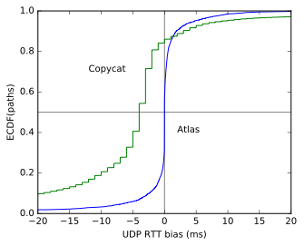
Is it possible to run the Internet over UDP? Preliminary Results
A/B testing for TCP/UDP connectivity
Copycat tool on 120 PlanetLab nodes
3,67% UDP blocking on port 33435
2,7% UDP blocking on all tested ports (33435,1228, 8008, 12345)
RIPE Atlas traceroute
3.661% UDP blocking based on existing traceroutes
We are currently running more measurements!
Use all existing testbeds available, e.g. CAIDA Ark, MONROE

Slide 7
Middlebox Cooperation:
Architectural Considerations
Shim for Middlebox Cooperation Protocol (MCP)
Transport and applications can selectively expose semantic information to middlebox
Higher layers can fully be encrypted
Flexible Transport Layer (FTL)
Maintain connectivity (even if the MCP is not supported) e.g. fallback or happy-eyeball mechanisms
Provision of encryption context for different layers/protocols

Slide 8
Problem Statement
Deployment problems of new protocols and protocol extension due to ossification in the Internet, e.g.
Multipath TCP
QUIC (over UDP)
Operation and management of in-network functionality hindered due to increasing deployment of encryption, e.g.
firewalls using port mapping or DPI
performance enhancements in mobile networks

Slide 9






Why a new shim?
Transport layer: end-to-end sockets
flow information
Internet layer: hop-by-hop handling
per-packet information
stateful and ‚smart‘ processing at the edge
Missing:
Per-flow information for
stateful in-network functions
stateless and simple processing in the middle
Path layer for explicit cooperation with middleboxes instead of implicit assumptions

Slide 10
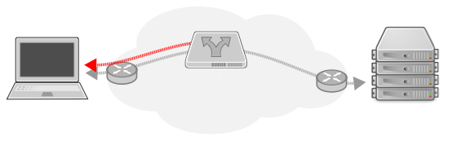
Path Layer: (Basic) Functional Requirements
Grouping of packets into flows
Extensibility to provide per-flow network information
Explicit feedback channel
magic
tube/group/flow id
resv
option space …
checksum

Slide 11
Example 1:
Firewall Traversal
Problem
UDP often blocked as it is hard to maintain state
Needed
group ID
start/stop signal and confirmation by receiver (‚SYN/ACK’)
Action
firewall can forward first packet and set up state based on confirmation from receiver
group ID must be large enough to not be guessable

Slide 12
Example 2:
Low Latency Support
Problem
Network service not optimized for latency sensitive traffic
Needed
Flag to signal loss sensitivity vs. latency sensitivity
Action
network device can treat latency sensitive traffic differently, e.g. in a separate smaller queue
trade-off between loss and latency gives not incentive to lie

Slide 13
Why should I trust what you say about your flows?
Default: trust but verify
declarative signaling: no negotiation, no guarantees
the best way to prevent cheating is to make it useless to do so
Leverage existing trust relationships for higher-assurance declarations
e.g. your enterprise firewall, access network middleboxes, etc.

Slide 14
Will it deploy?
Transport-layer encapsulation over UDP
Need ports for NAT
Impossible to deploy with new protocol number across the Internet
Userspace (and kernelspace) implementation possible
Magic number for easy recognition, protection against reflection
Flags for “SYN/ACK” condition for state decision delegation to endpoint
All traffic bidirectional
Data in first packet possible
Signals fit in a single packet (no segmentation or reliability)
Checksum for error detection, cryptographic integrity checks available

Slide 15
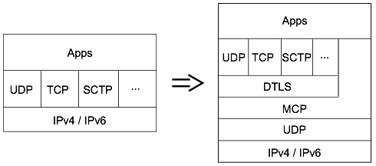
Implementing an Explicit Path Interface
Application can directly indicate requirements to path layer
Transport can use the path layer to expose parts of its functionality/intentions to the network
Middlebox Cooperation protocol (MCP) signals these information appropriately to on-path middleboxes

Slide 16
References
Substrate Protocol for User Datagrams (SPUD) in the IETF
draft-trammell-spud-req
draft-kuehlewind-spud-use-cases
draft-hildebrand-spud-prototype
IAB Stack Evolution Program
Workshop on Stack Evolution in a Middlebox Internet (SEMI) 2015 [RFC7663]
B. Trammell, J. Hildebrand: Evolving Transport in the Internet
IRTF proposed research group on Measurement and Analysis for Protocols (MAPRG)
MAMI webpage (mami-project.eu) or twitter (@mamiproject)

Slide 17
Summary and Conclusion
Problem
Ossification of the Internet Protocol Stack
Needed
Measurement to identify path impairments
Large-scale using all available testbeds (incl. MONROE)
New measurements tools (Tracebox, PathSpider)
Path Transparency Observatory
Path layer for explicit middlebox cooperation
Middlebox Cooperation Protocol (MCP): trust by verify
Encrypted everything else!

